Slide 1
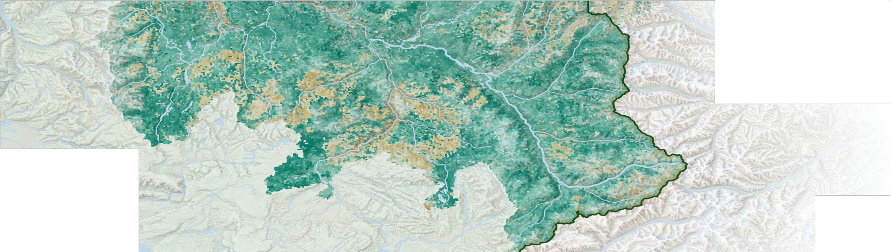


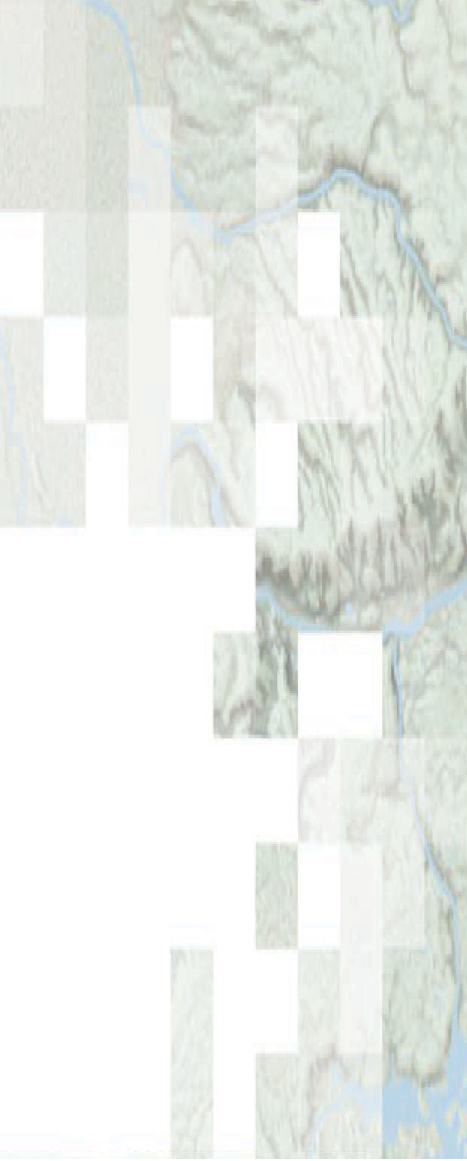


!"#$%&"' )*+%&",#$-. "&/ 01"-* )/2$&$.#+"#$%&
The ITCOocean hack2week content includes slides from NASA ARSET. Slides without the NASA logos were prepared by Eli Holmes (NOAA) and those with the NASA logos are from ARSET.
Species Distribution Modeling with Remote Sensing
Amber McCullum, Juan Torres-Perez, Zach Bengtsson
Aug 12, 2021

Slide 2
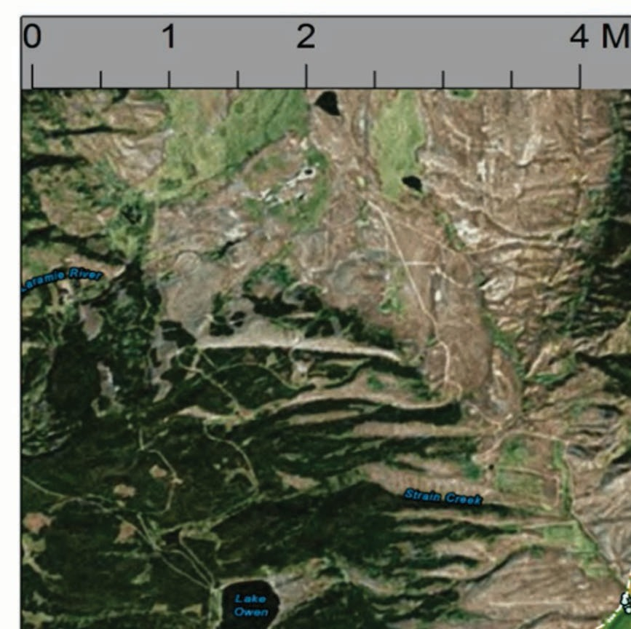
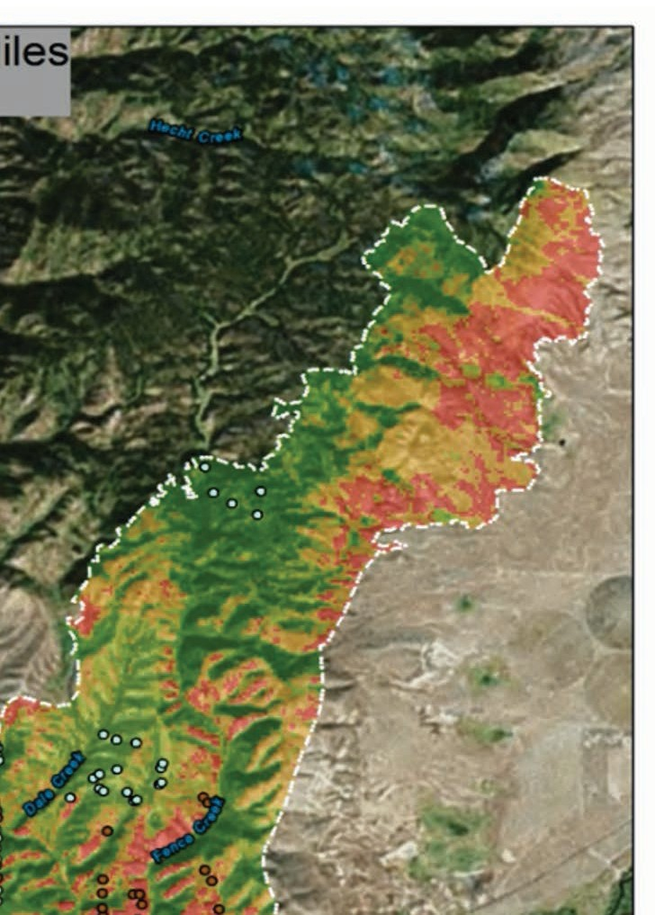
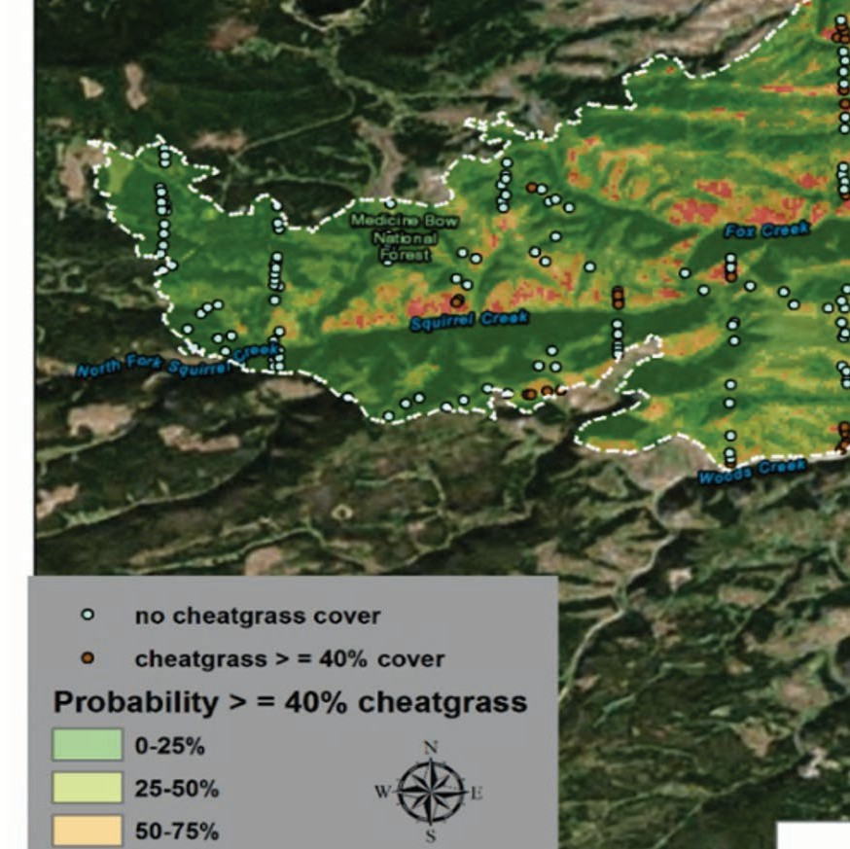
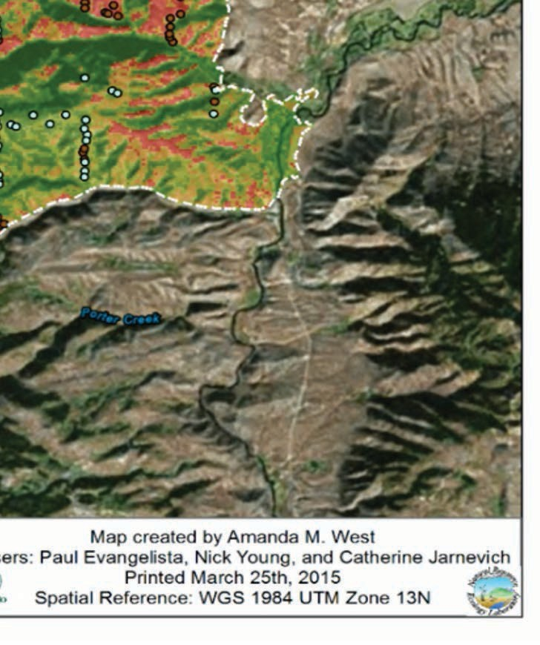
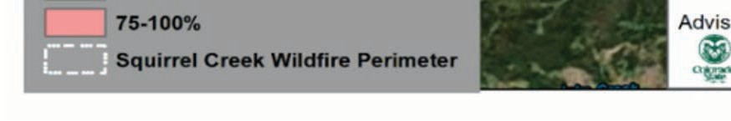
SDM Overview
Week 1 – SDM overview
Species Distribution Models (SDMs) overview
Occurrence data – IndOBIS by Johnny Konjarla
SDM environment data overview
Application lecture by Ben Best
More occurrence data
Week 2 – SDMs in R
Occurrence Data
Environmental Variables
Methods and Models
Case Study Examples
Question and Answer Session
ARSET image
4

Slide 3
Occurrence Data

Slide 4
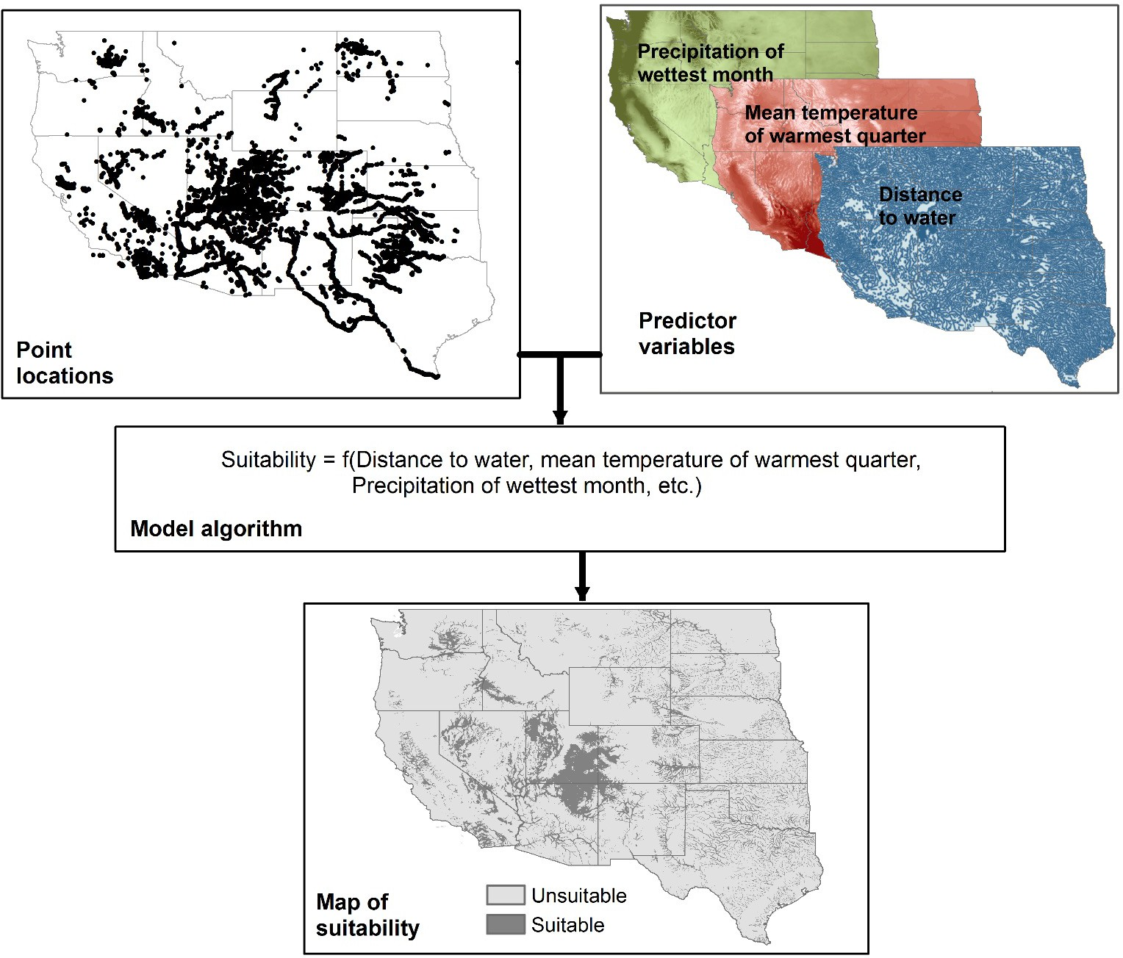
Occurrence Data
!"#$%&'() %* ",- ./01

Slide 5
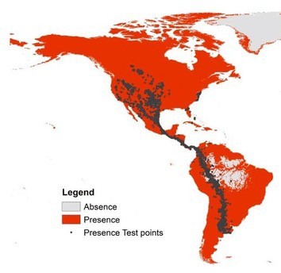
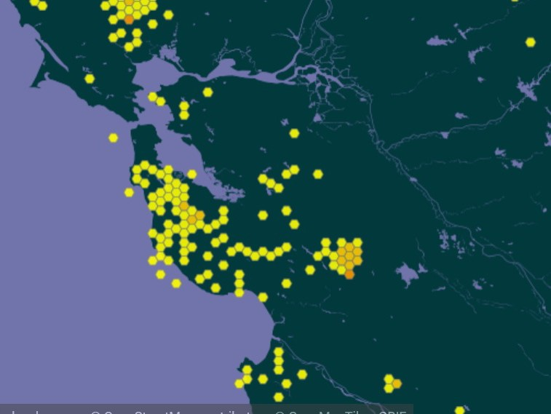
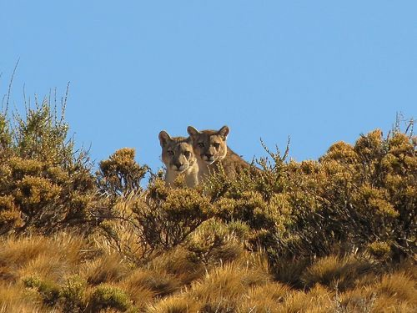
Occurrence
Ground-based observations
Presence only OR presence and absence
!"#
%&"#'()'*
Puma presence locations in the San Francisco Bay Area from GBIF
Presence/Absence map for Peregrine Falcon. Image Credit: Sriram and Huettmann, 2017

Slide 6
Absence Data
A species may be classified as ‘absent’ for a number of reasons, but this does not necessarily denote the absence of suitable conditions.
" The environment is truly unsuitable for the species.
True absence
" The species could not be detected, even though it was
present. False absence
" The species was absent, even though the environment
is suitable (e.g., due to dispersal limitation or metapopulation dynamics).
Resource on pseudo-absence: Massin et al, 2012
False absence

Slide 7
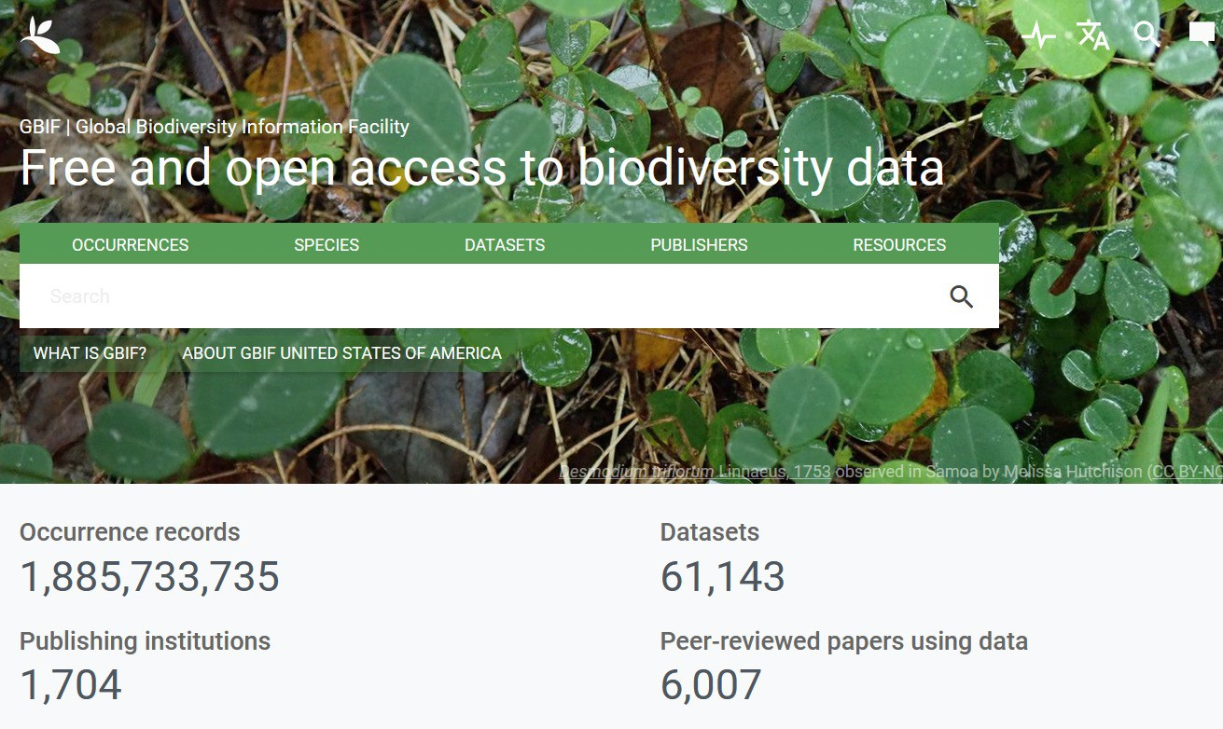
Global Biodiversity Information Facility (GBIF)
https://www.gbif.org
International network and research infrastructure funded by the world's governments and aimed at providing anyone, anywhere, open access to data about all types of life on Earth
Nearly 1.5 billon occurrence records
60% of all named species
Data standards and open access

Slide 8
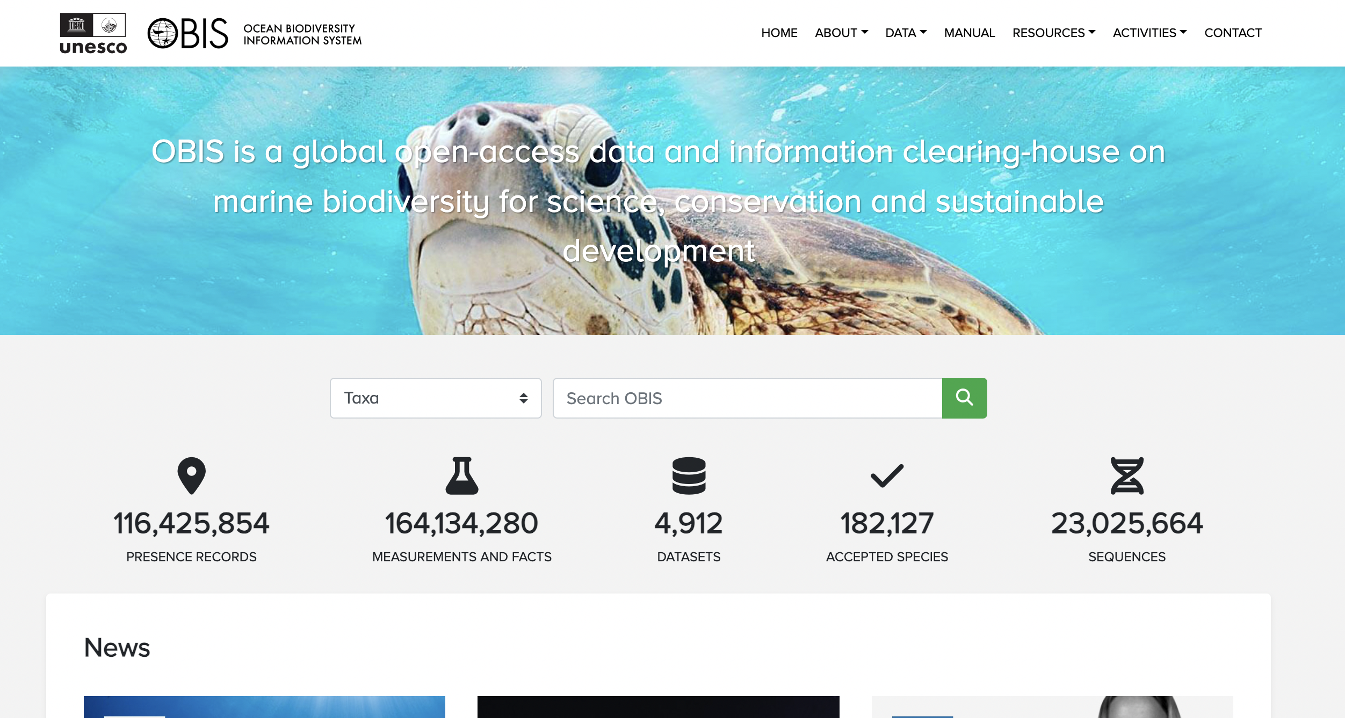
Global Biodiversity Information Facility (OBIS)
https://www.obis.org
International network aimed at providing anyone, anywhere, open access to marine biodiversity and location data.
Over a million occurrence records, but sparse in the Indian Ocean
Data standards and open access

Slide 9
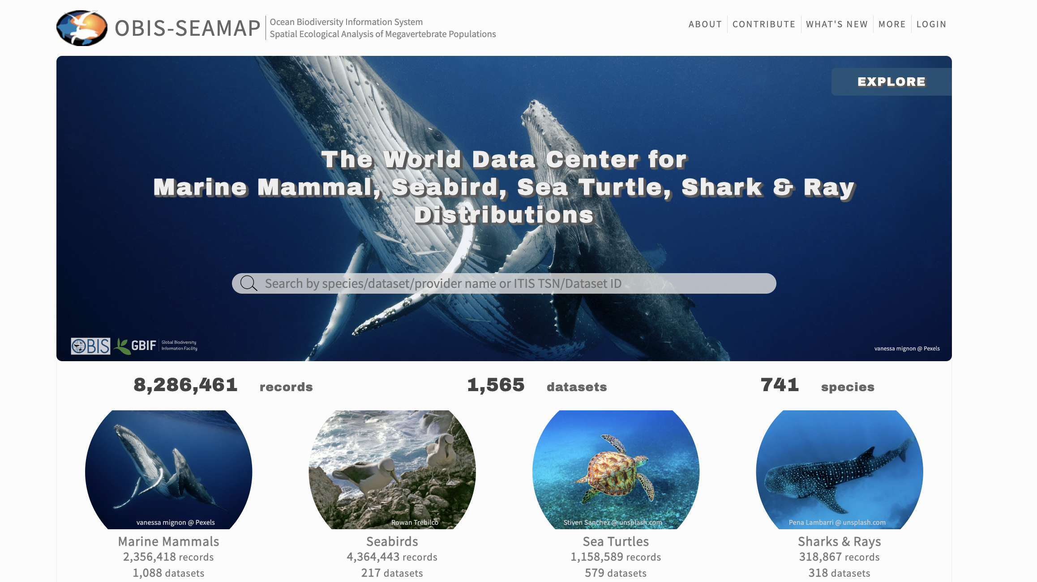
Spatial Ecological Analysis of Megavertebrate Populations (OBIS-SEAMAP)
https://seamap.env.duke.edu/
In the OBIS network and focused on marine mammals, seabirds, sea turtles, sharks and rays

Slide 10
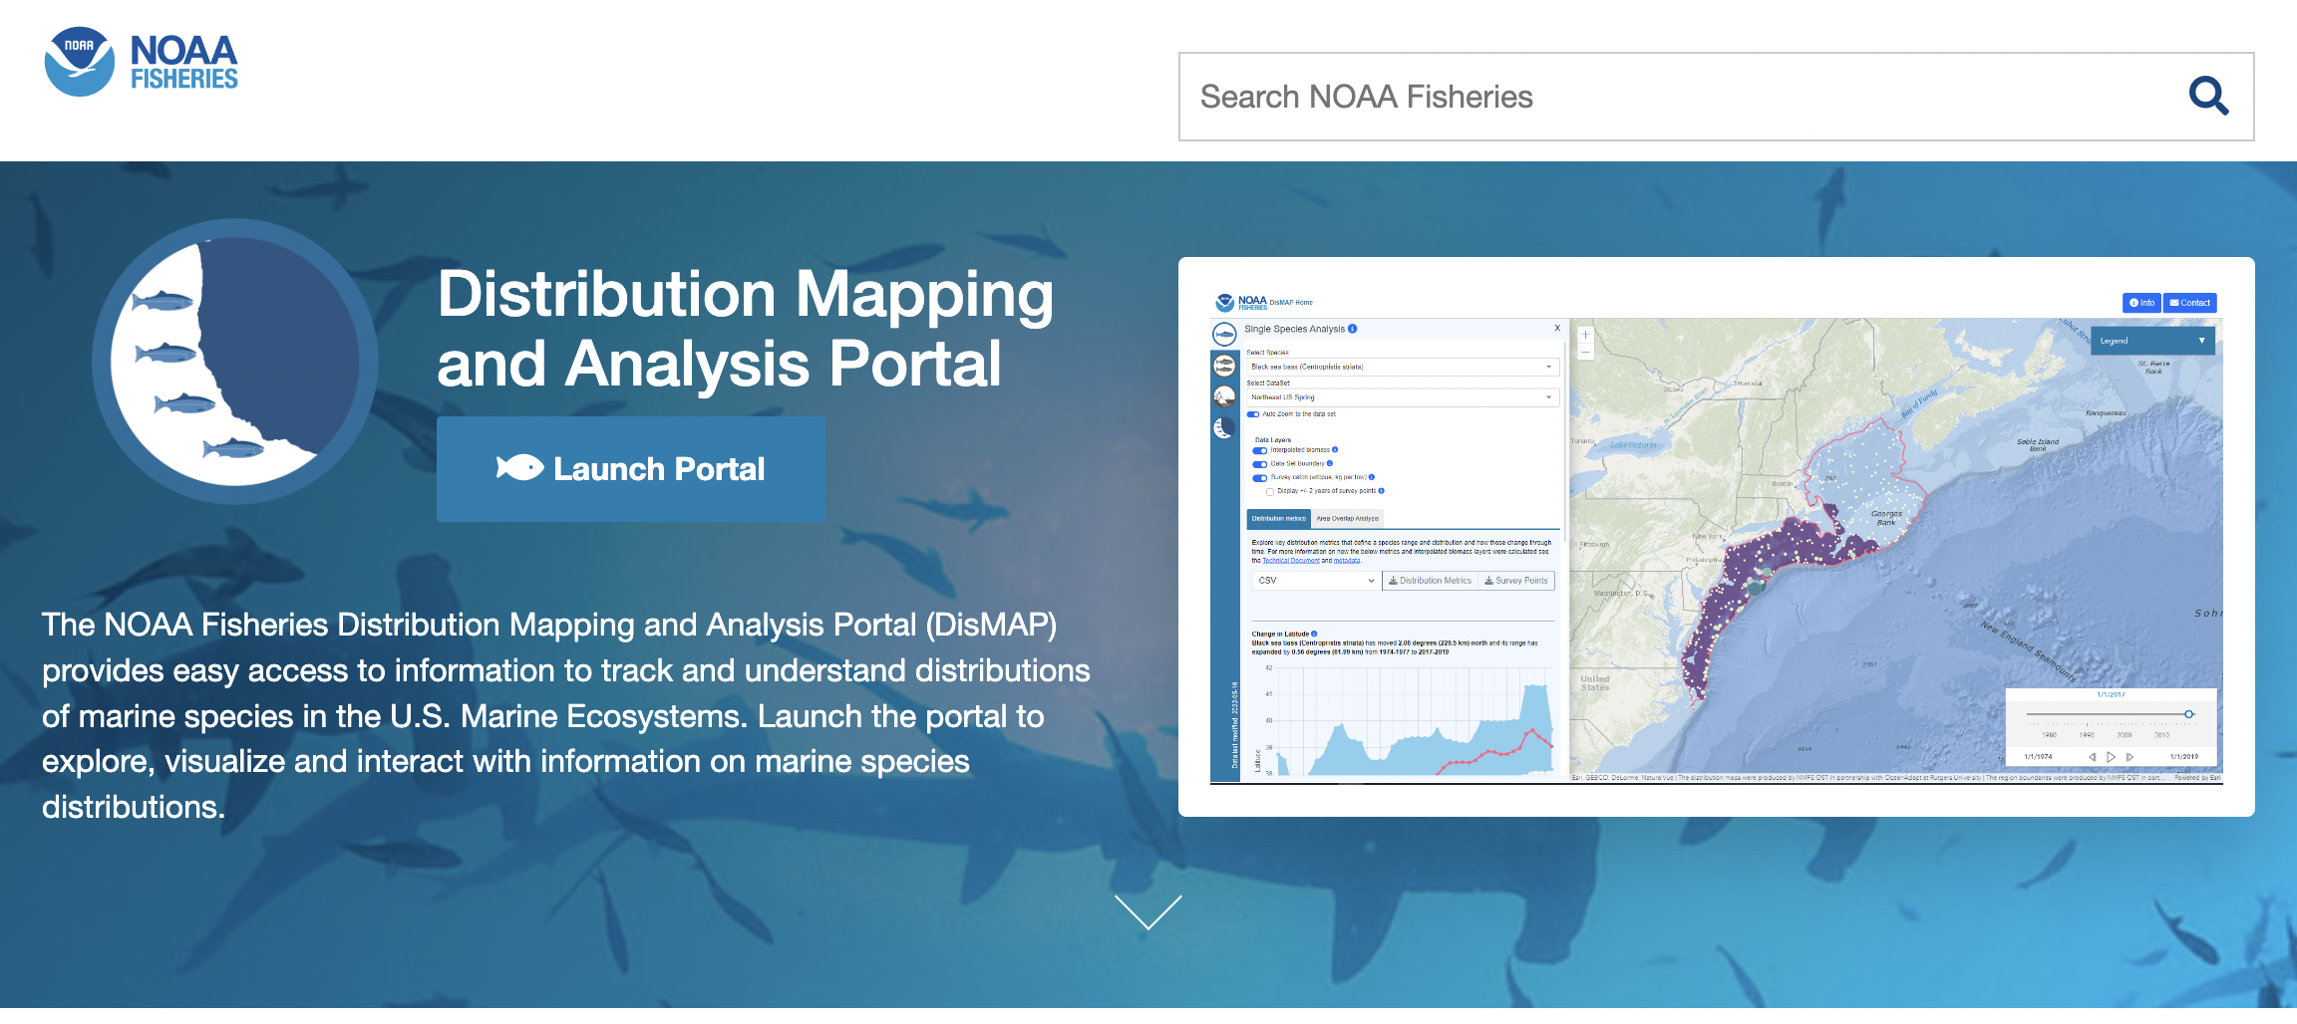
NOAA Dismap
https://apps-st.fisheries.noaa.gov/dismap/
For US waters but might be useful for comparative studies
Has mostly commercial fish species so quite different than what you will find on OBIS
Uses the US public commercial fish survey data

Slide 11
Land Occurrence Data – for inspiration

Slide 12
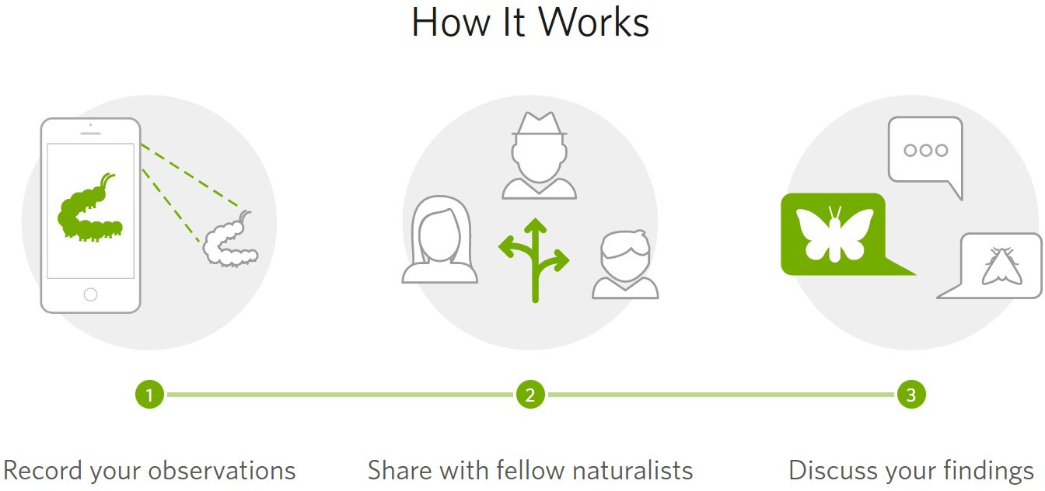
iNaturalist
https://www.inaturalist.org
Citizen science smartphone application for recording and sharing species information
Connect with other observers
Contribute to a specific project
Hold events for field campaigns
Share data with GBIF

Slide 13
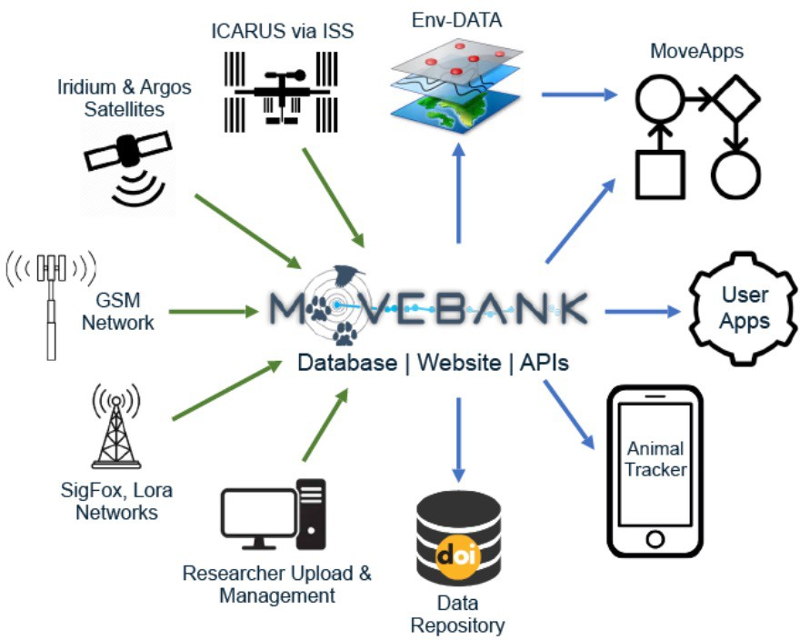
Movebank
https://www.movebank.org/cms/movebank-main
Online platform that helps researchers and wildlife managers worldwide manage, share, analyze, and archive animal movement data
" Archive animal movement
" Enable collaborations
" Help scientists address new questions
" Promote open access

Slide 14
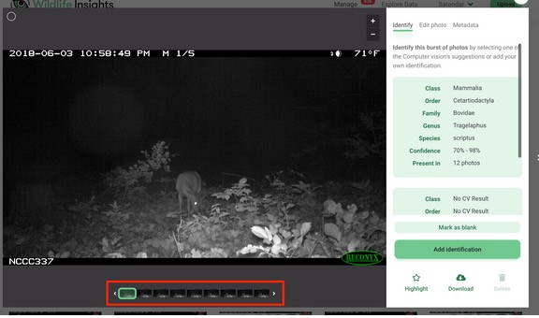
Wildlife Insights
https://www.wildlifeinsights.org
Collection, dissemination, and analysis of camera trap data globally
Combines field and sensor expertise, cutting edge technology and advanced analytics to enable people everywhere to share wildlife data and better manage wildlife populations
Upload images to website for species identification with artificial intelligence

Slide 15
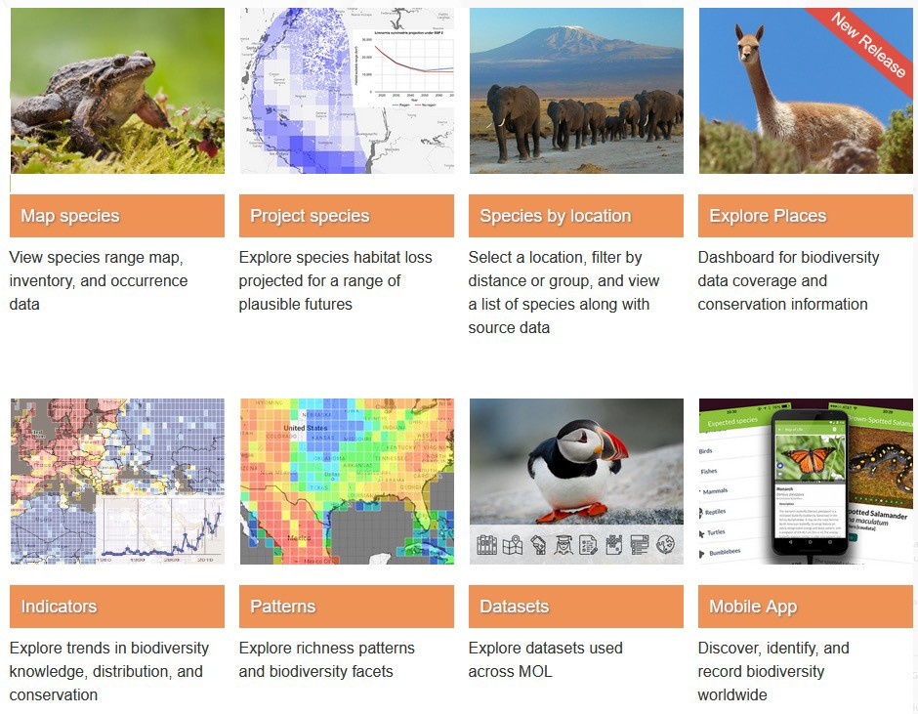
Map of Life (MOL)
https://mol.org
Provides species range information and species lists for any geographic area
Multiple tools for exploring species habitat and trends in biodiversity
Mobile app for discovering, identifying, and recording biodiversity

Slide 16
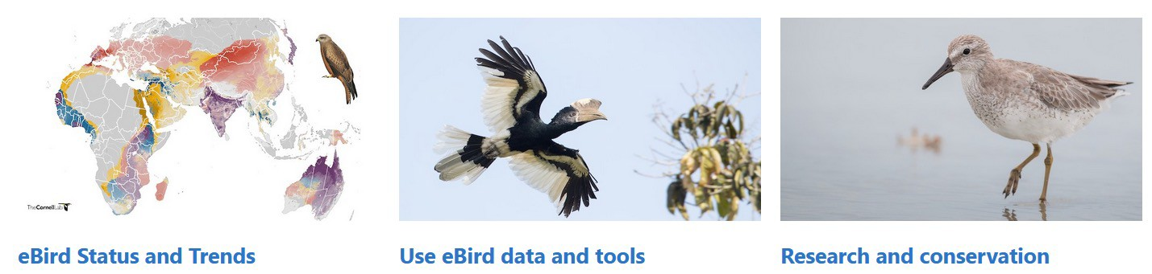
eBird
https://ebird.org/home
Gather and share bird information for science, conservation, and education
Mange lists, photos, and recordings
Real-time maps of species distributions
Species alerts
100 million bird sightings annually

Slide 17
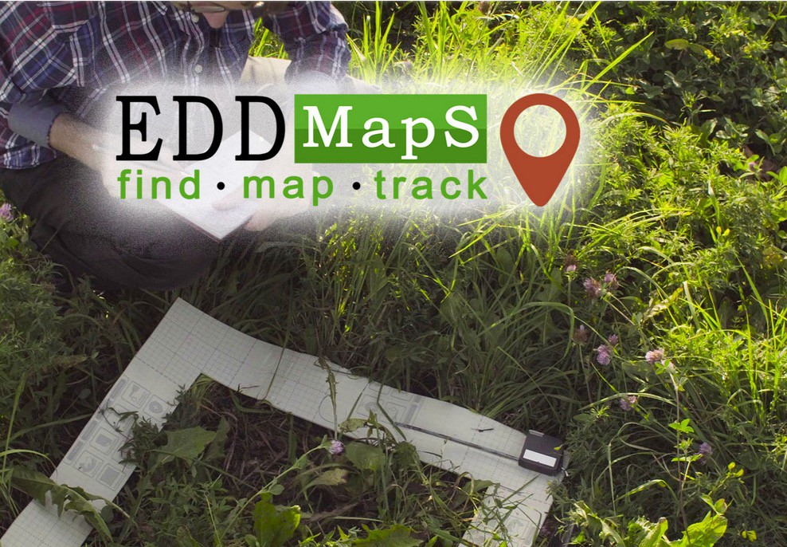
Early Detection and Distribution Mapping System (EDDMaps)
https://www.eddmaps.org
Web-based mapping system for invasive species and pest distribution
US and Canada
" Interactive distribution maps
Aggregates data from other databases and volunteer observations
All data freely available

Slide 18
ARSET Contacts for this training content
Trainers:
" Juan Torres-Pérez: juan.l.torresperez@nasa.gov
" Amber McCullum: amberjean.mccullum@nasa.gov
" Zach Bengtsson: bengtsson@baeri.org
Follow us on Twitter @NASAARSET
Training Webpage:
" https://appliedsciences.nasa.gov/join-mission/training/english/arset-species- distribution-modeling-remote-sensing
ARSET Website:
" https://appliedsciences.nasa.gov/what-we-do/capacity-building/arset

